Slide 1

Code Refactoring and Bug Fixing

Slide 2
About me
Background : B-tech
Why you want to learn Data Science
I’m veru much interested in data and data handling methods and also to analyse the data.
Any work experience
NO
Share your linkedin and github profile urls
LinkedIn: www.linkedin.com/in/ajaykumarthumu
GitHub: https://github.com/Ajay73339

Slide 3
Agenda
Refactor the existing codebase and ensure the proper functioning of the Note Taking Application. Document all identified bugs during the debugging process. Remember, the task is not about recreating the app from scratch. Your goal is to fix the already existing codebase and make the application work as intended.

Slide 4
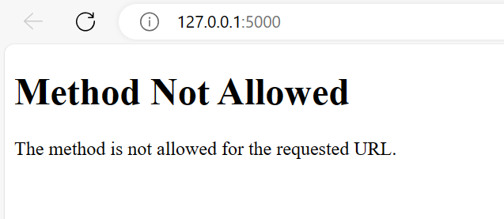
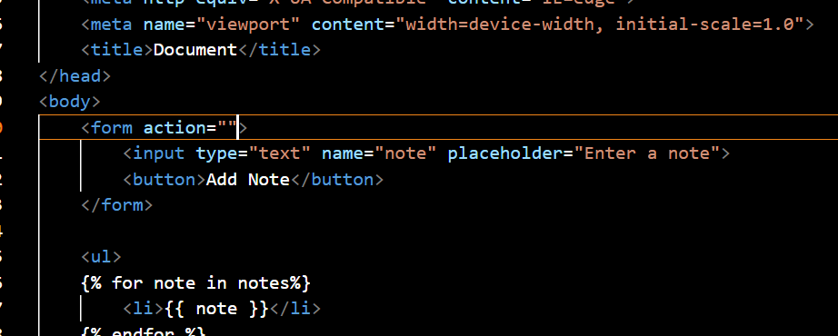
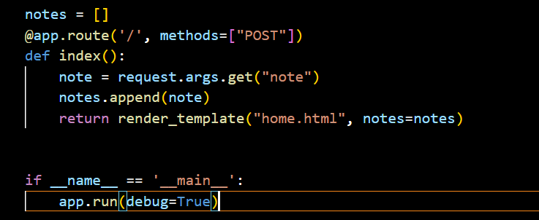
Errors:
Reasons:
In the HTML template we didn’t specify any method but clearly in the app.py program we specified,
that it will be POST method as we can observe from the below fig.

Slide 5
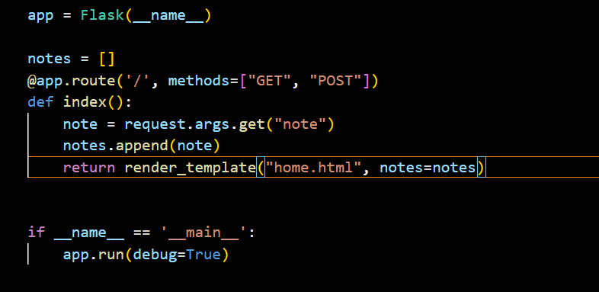
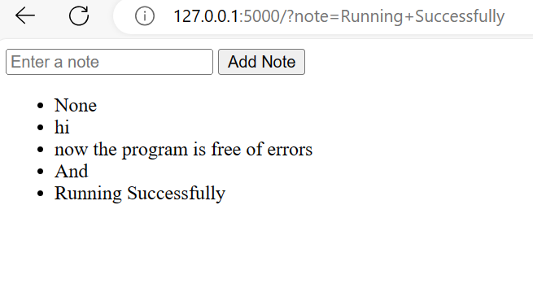
Fixing Issues:
We can easily fix the issue by adding get method in the methods in app.py program.
Result:

Slide 6

THANK YOU

